Slide 2
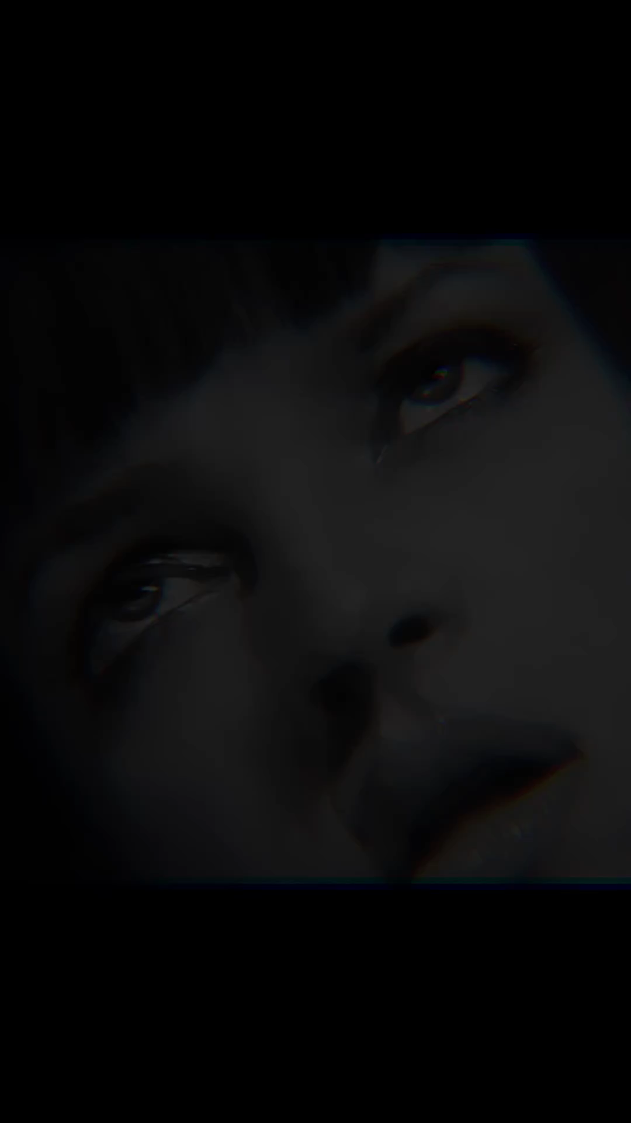
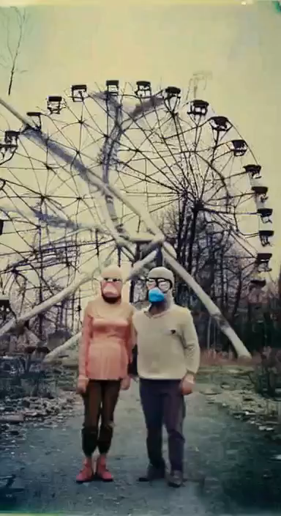
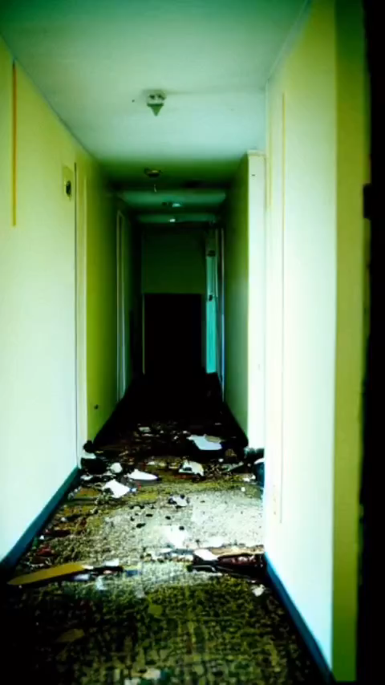

Slide 3


Slide 4
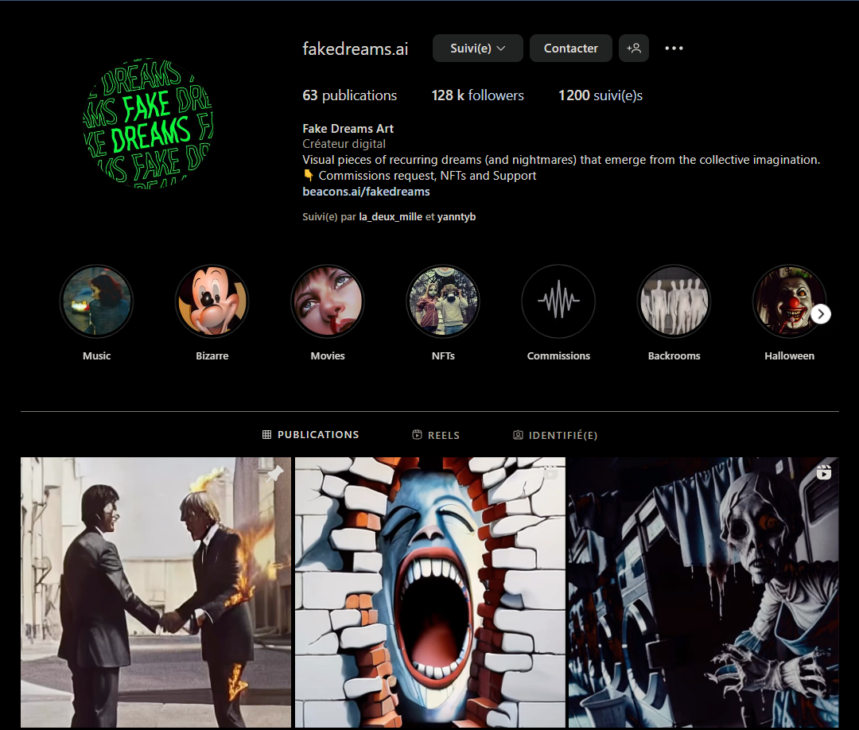

Slide 5
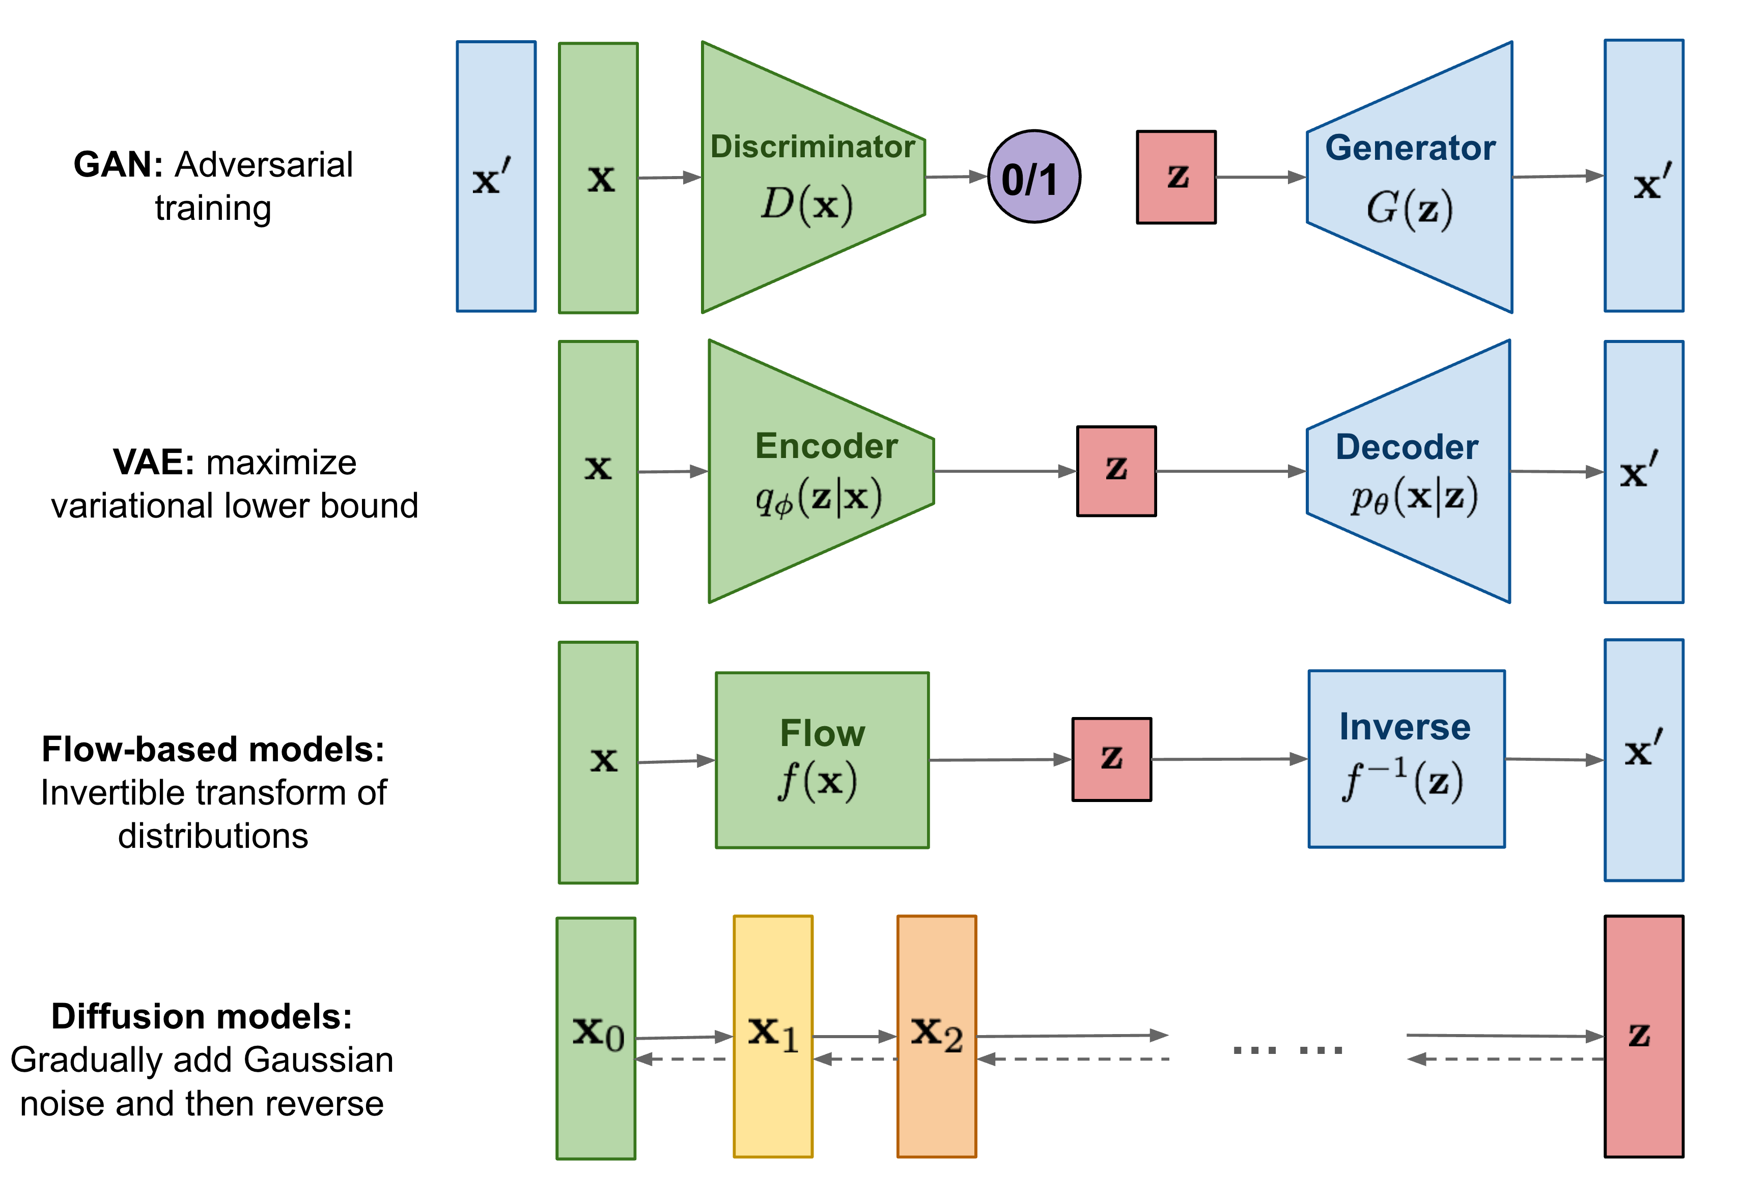
Generate images

Slide 6
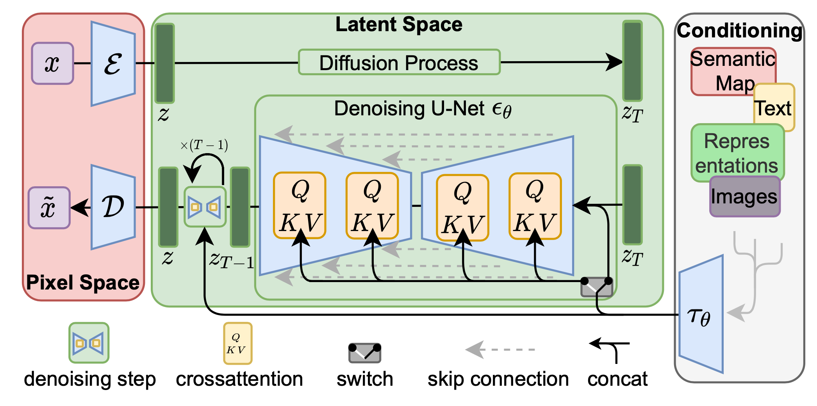
The architecture of latent diffusion model

Slide 7
How training is done : the big step
Pick a training image, like a photo of a cat.
Generate a random noise image.
Corrupt the training image by adding this noisy image up to a certain number of steps.
Teach the noise predictor to tell us how much noise was added. This is done by tuning its weights and showing it the correct answer.
Spoiler : We’ll do this backward to generate images

Slide 8

First step : forward diffusion

Slide 9
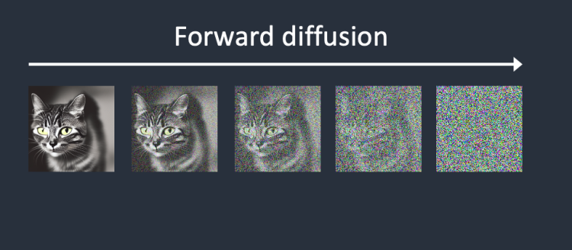
First step: forward diffusion

Slide 10
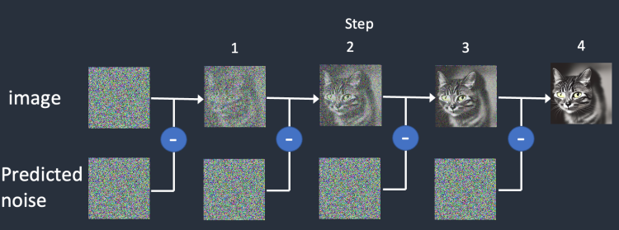
Step two: Reverse diffusion

Slide 11
Step two: Reverse diffusion

Slide 12
Conditioning

Slide 13
The architecture of latent diffusion model

Slide 14
Step by step

Slide 15
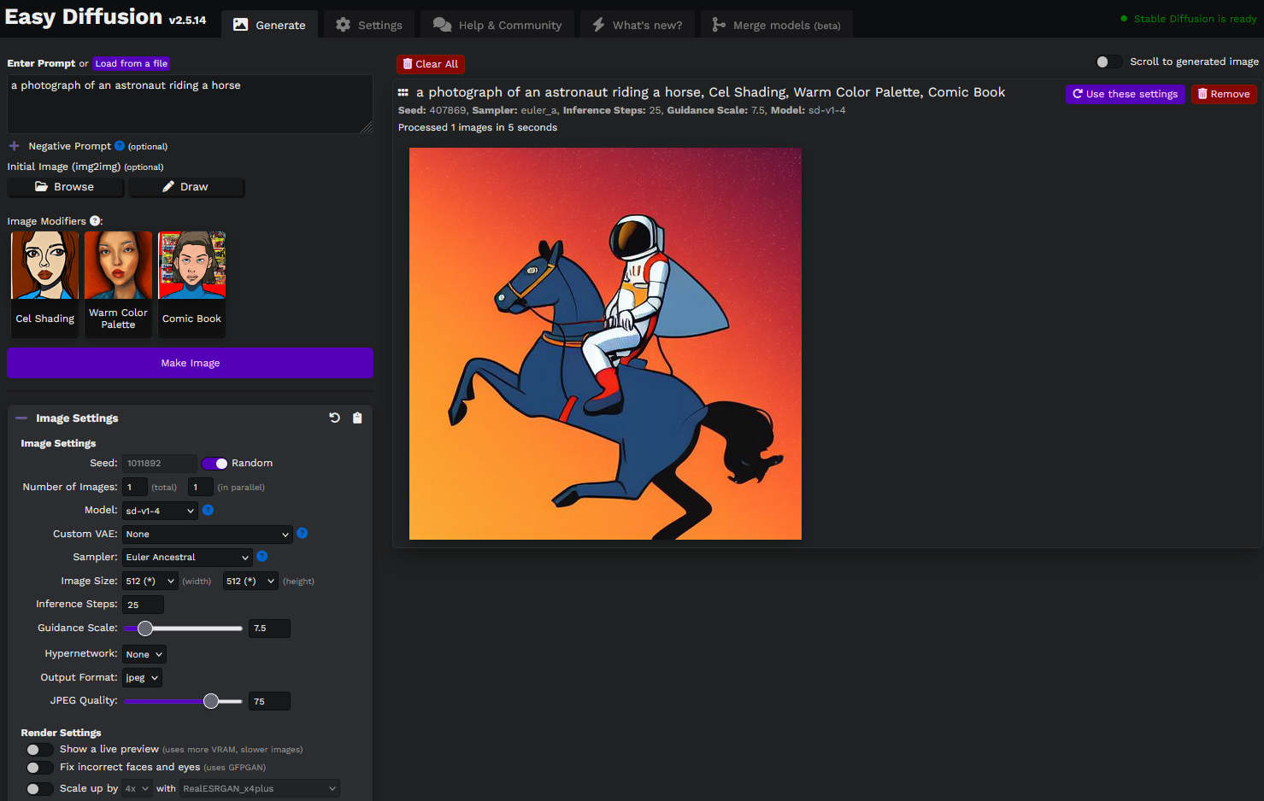
Self host

Slide 16
Sources
Diffusion models explained. How does OpenAI's GLIDE work? - AI Coffee Break with Letitia
Weng, Lilian. (Jul 2021). What are diffusion models? Lil’Log. https://lilianweng.github.io/posts/2021-07-11-diffusion-models/.
How does Stable Diffusion work? - Andrew https://stable-diffusion-art.com/how-stable-diffusion-work/

